Slide 1

Notes:
Opening slide: Emphasize the transformative nature of our platform Highlight the immediate value proposition for both parents and providers

Slide 2

Notes:
Key pain points that resonate with parents Emphasize the financial burden Highlight the systemic issues

Slide 3

Notes:
Key pain points that resonate with parents Emphasize the financial burden Highlight the systemic issues

Slide 4
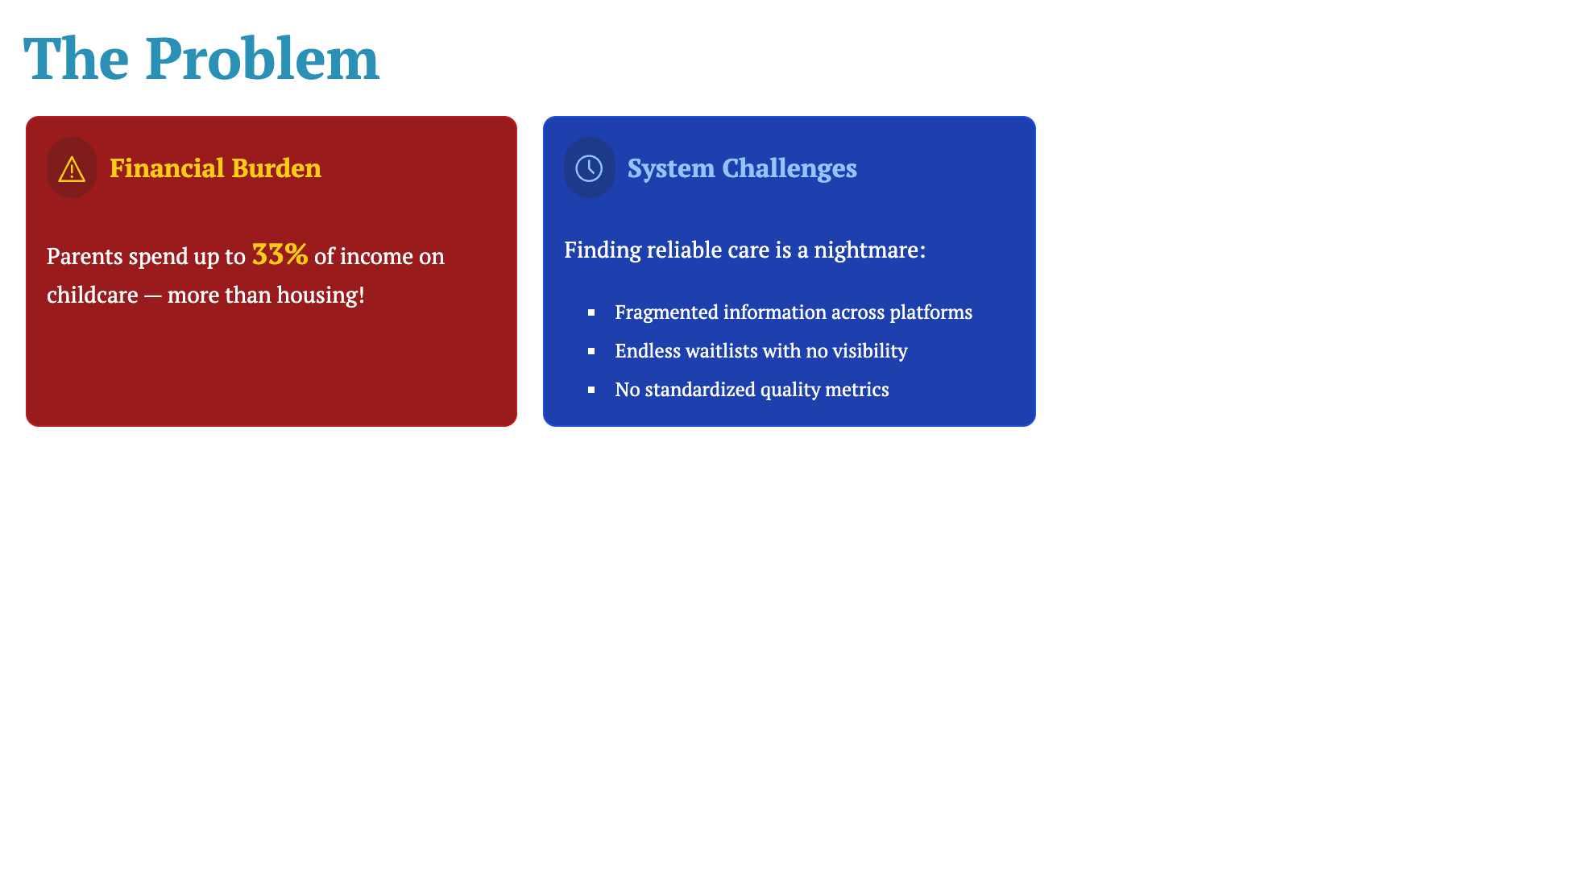
Notes:
Key pain points that resonate with parents Emphasize the financial burden Highlight the systemic issues

Slide 5
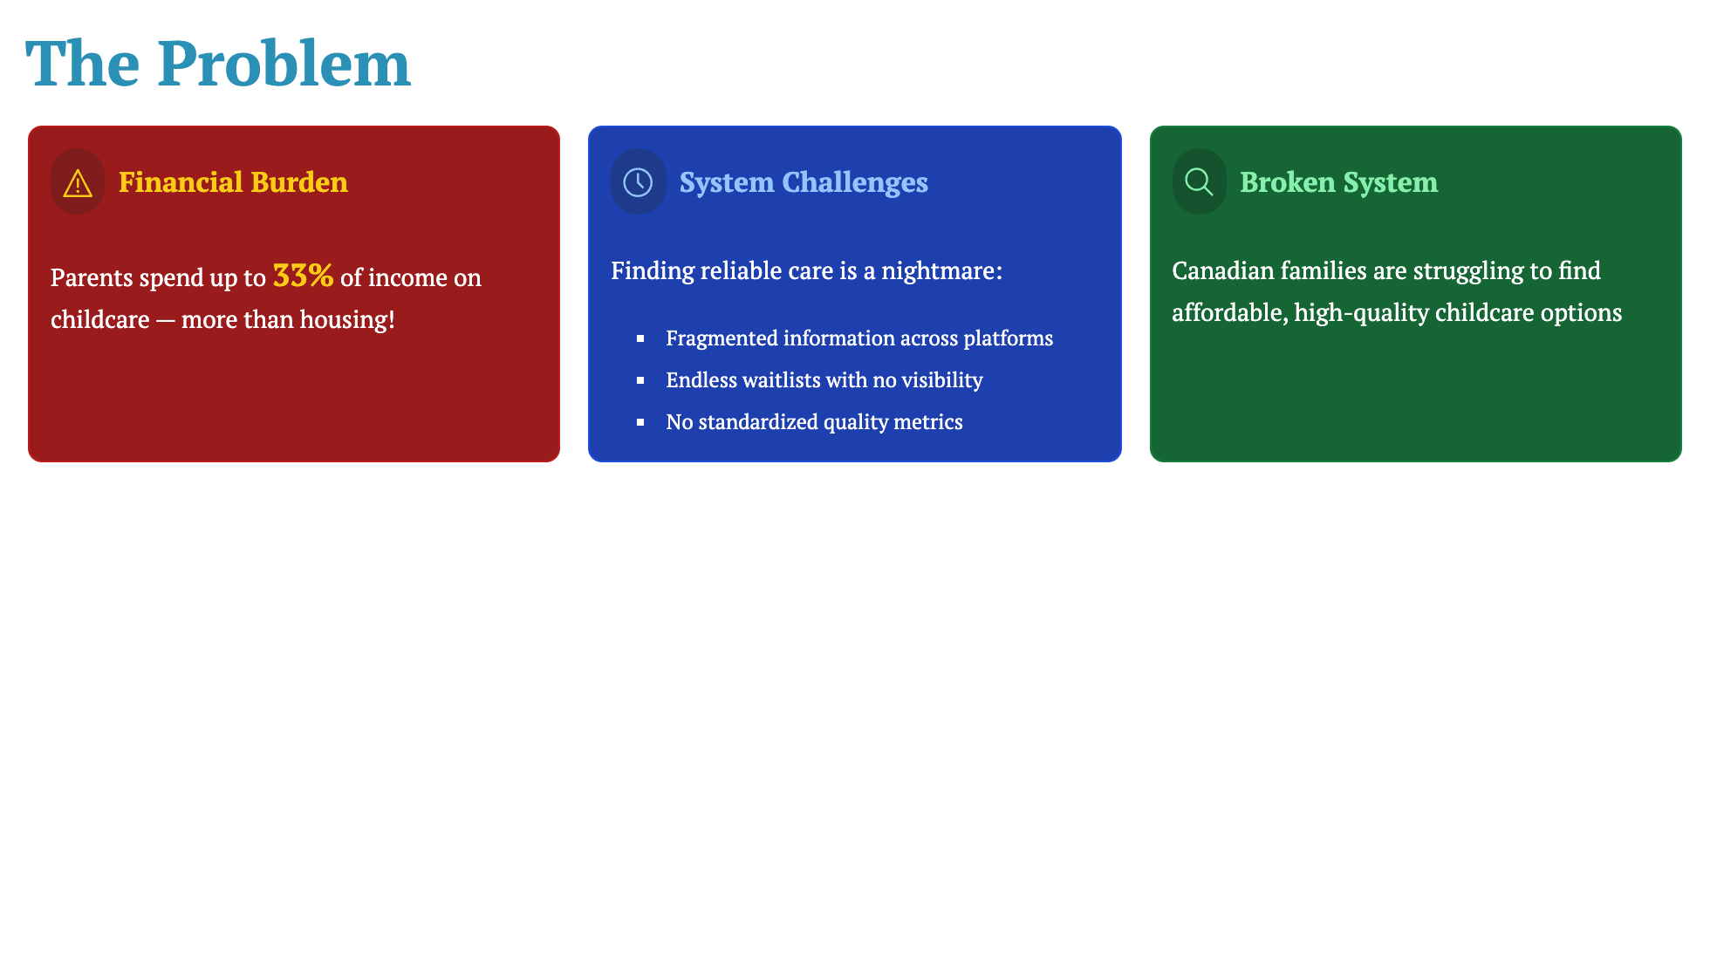
Notes:
Key pain points that resonate with parents Emphasize the financial burden Highlight the systemic issues

Slide 6
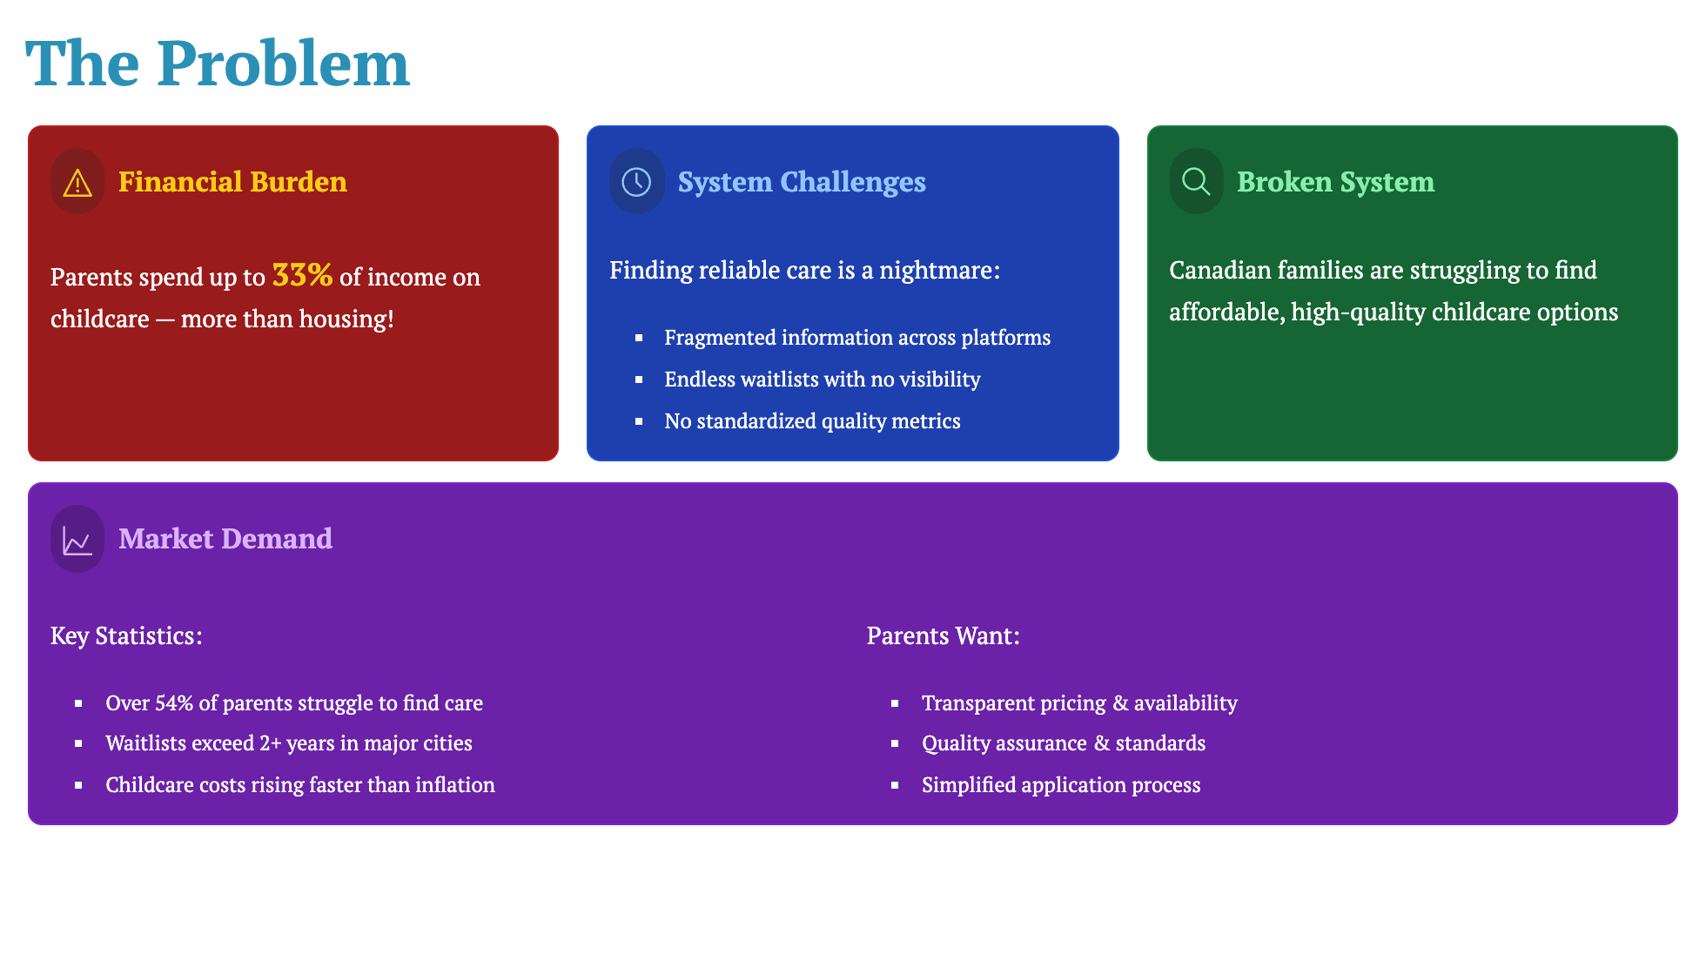
Notes:
Key pain points that resonate with parents Emphasize the financial burden Highlight the systemic issues

Slide 7
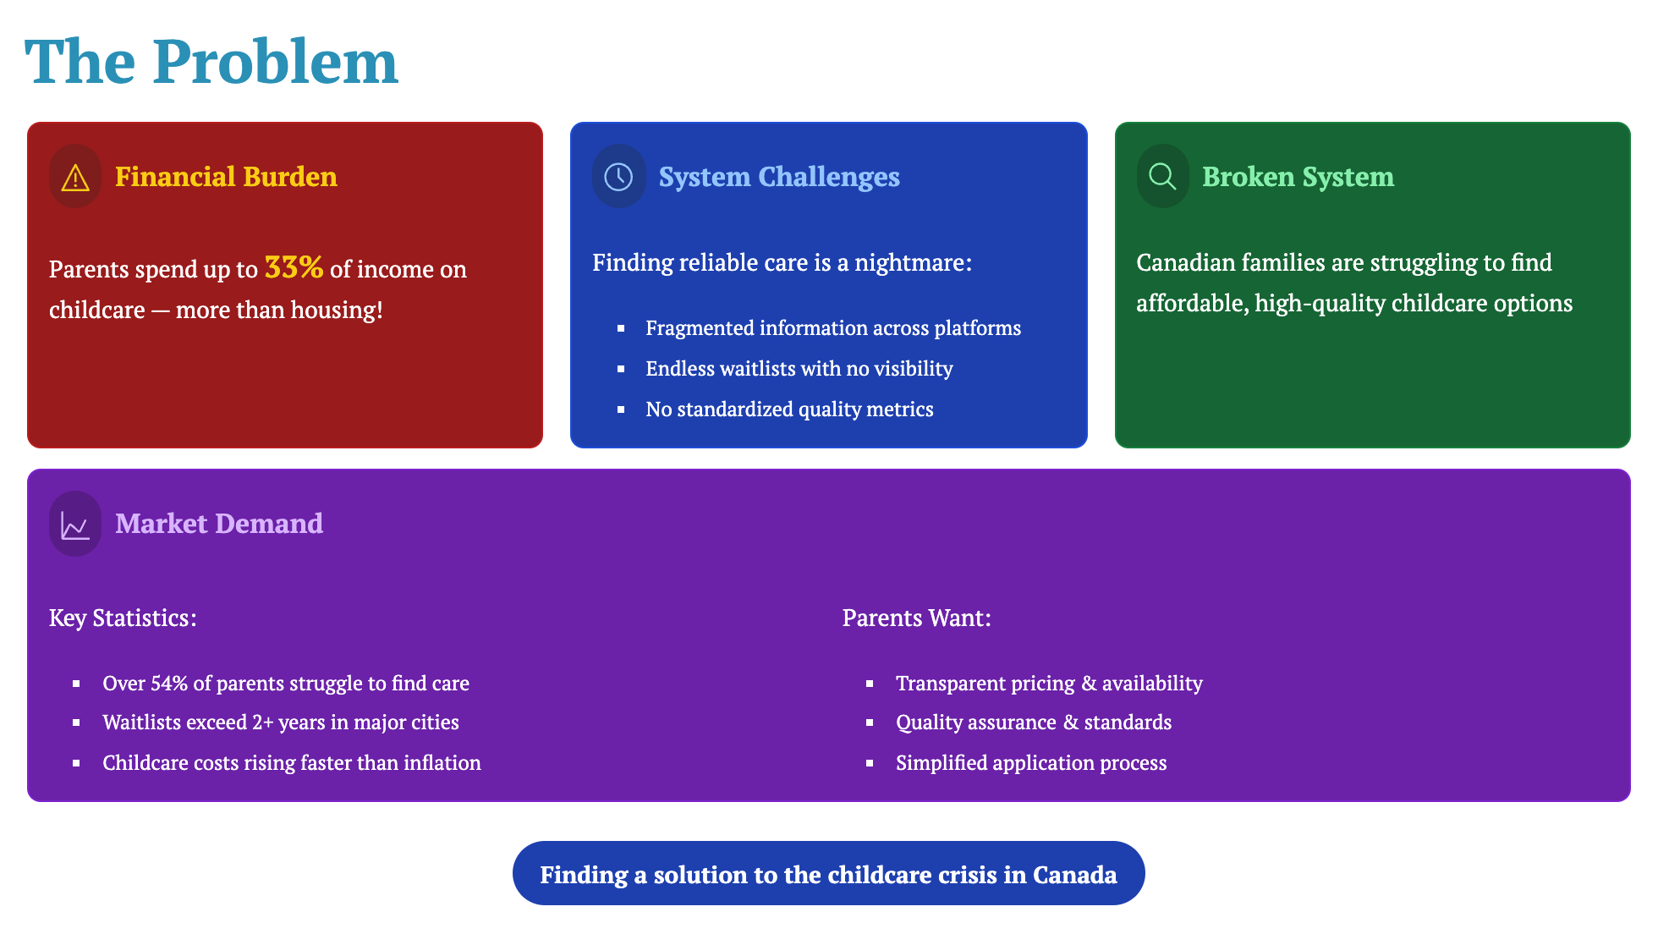
Notes:
Key pain points that resonate with parents Emphasize the financial burden Highlight the systemic issues

Slide 8
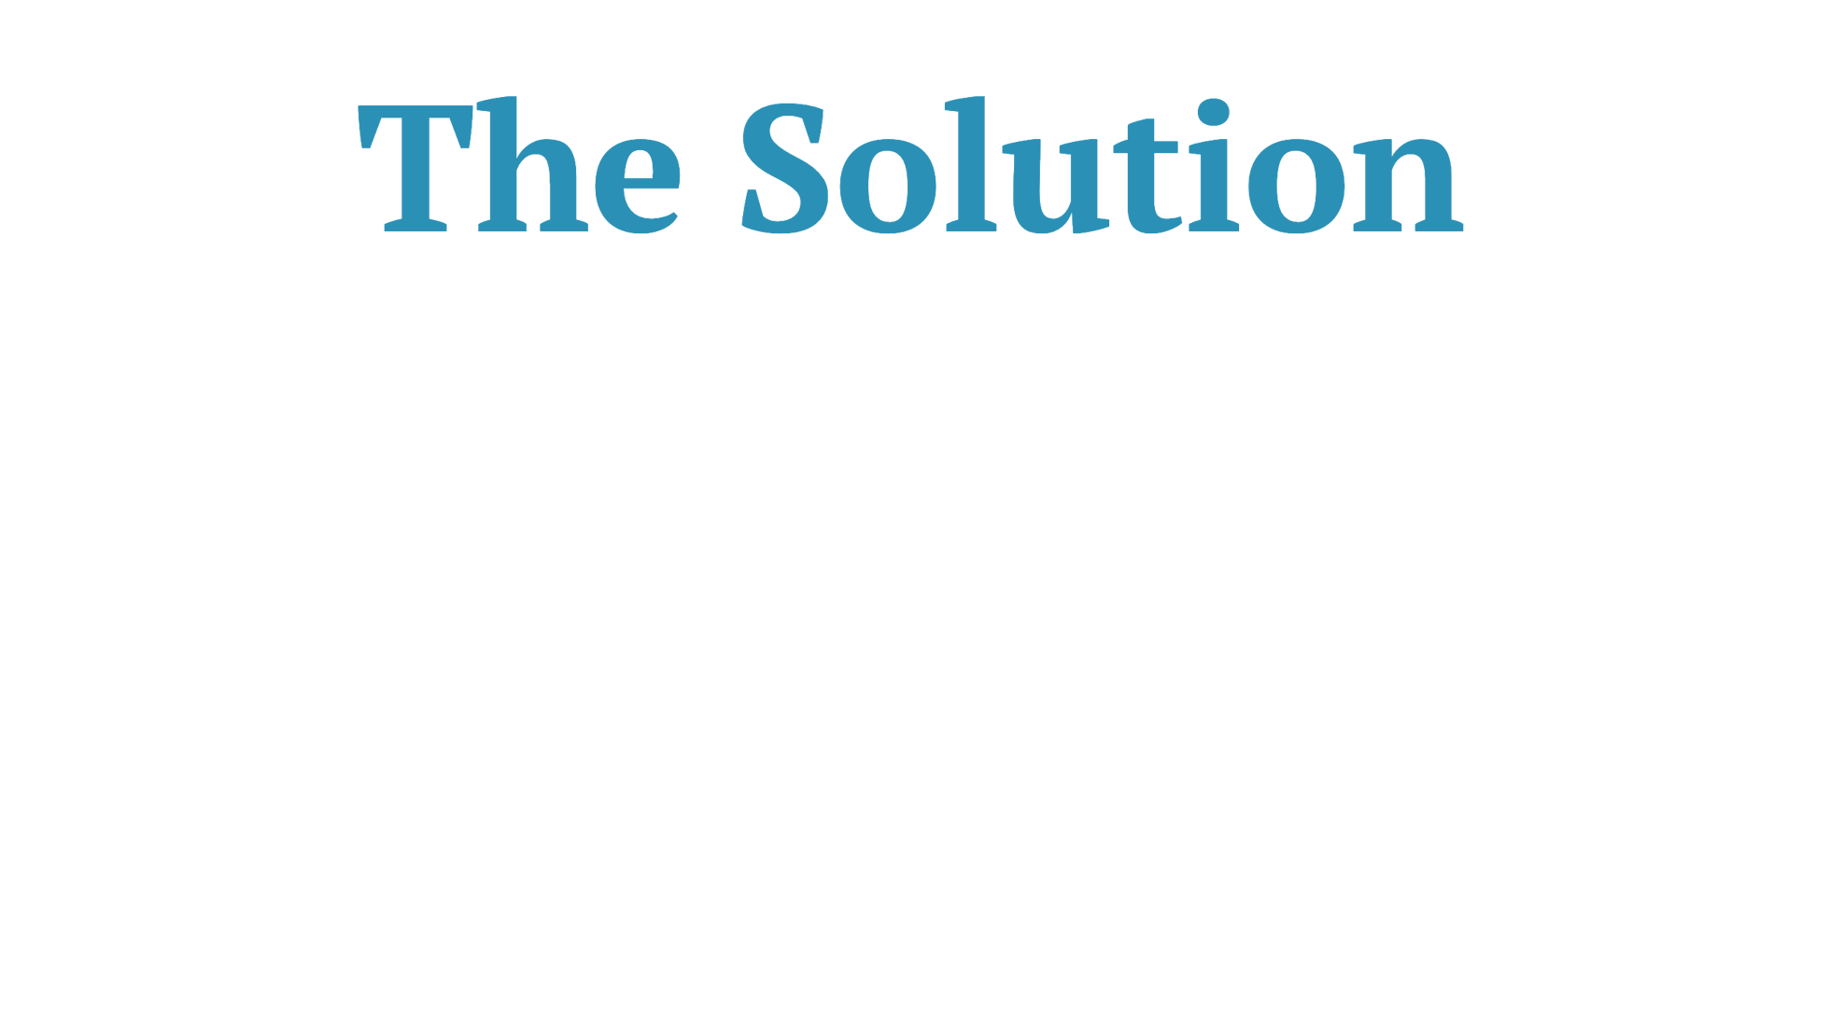

Slide 9
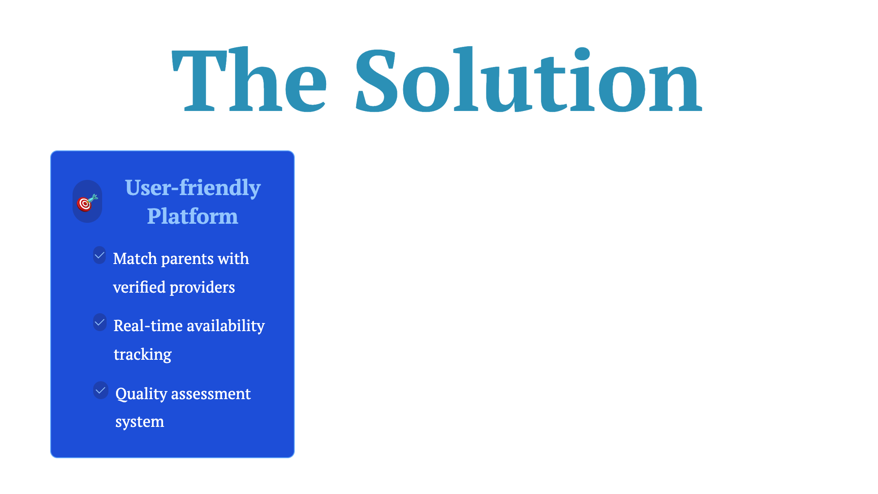

Slide 10
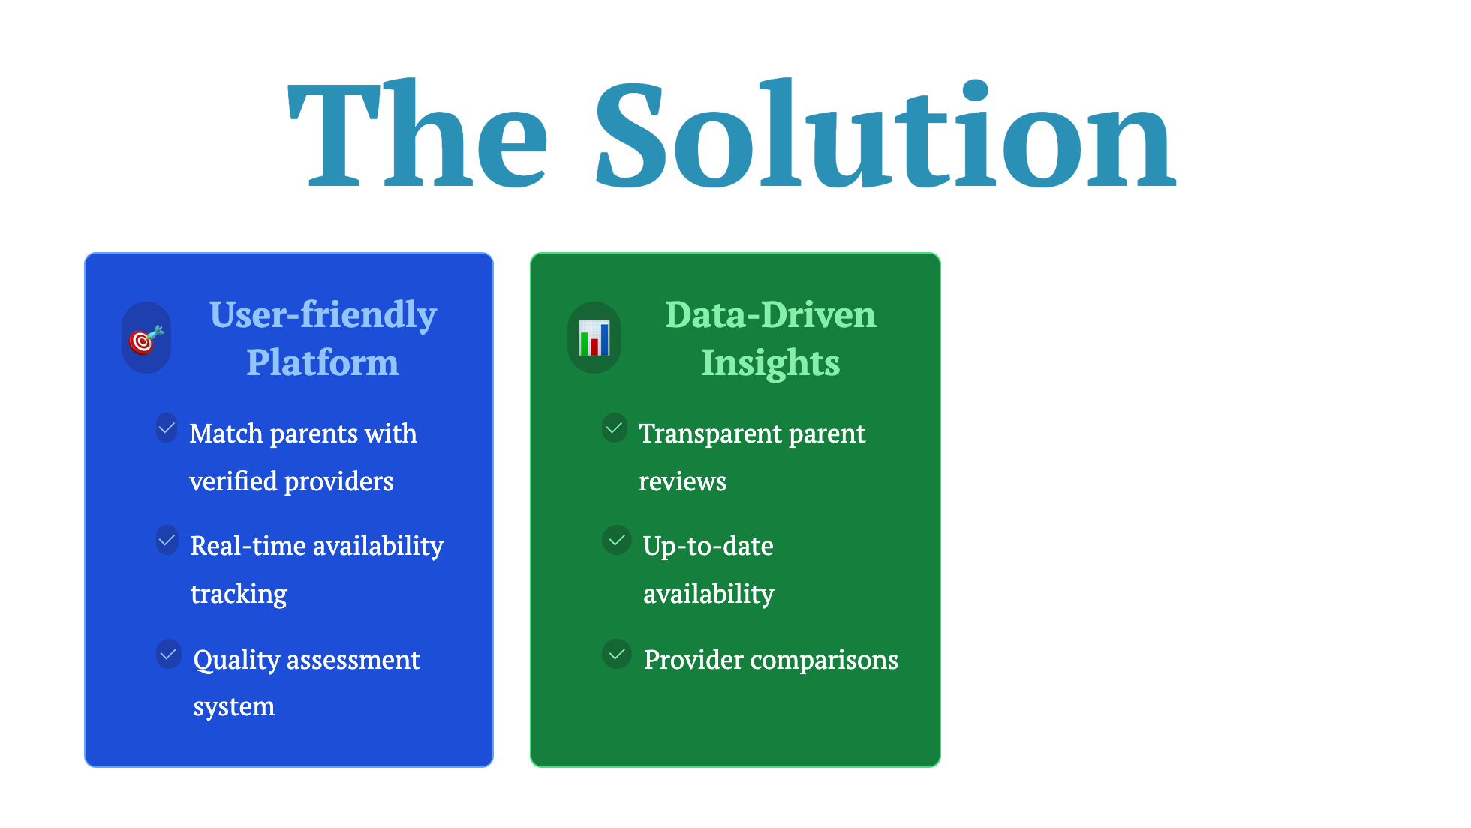

Slide 11
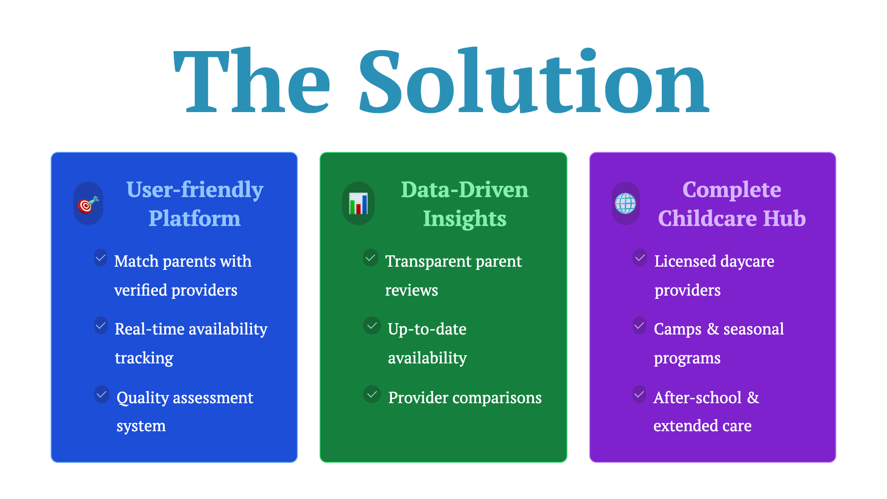

Slide 13

Notes:
Emphasize the massive market potential Highlight government support and policy changes

Slide 14

Notes:
Emphasize the massive market potential Highlight government support and policy changes

Slide 15

Notes:
Emphasize the massive market potential Highlight government support and policy changes

Slide 16

Notes:
Emphasize the massive market potential Highlight government support and policy changes

Slide 17

Notes:
Emphasize the massive market potential Highlight government support and policy changes

Slide 18

Notes:
Emphasize the massive market potential Highlight government support and policy changes

Slide 19
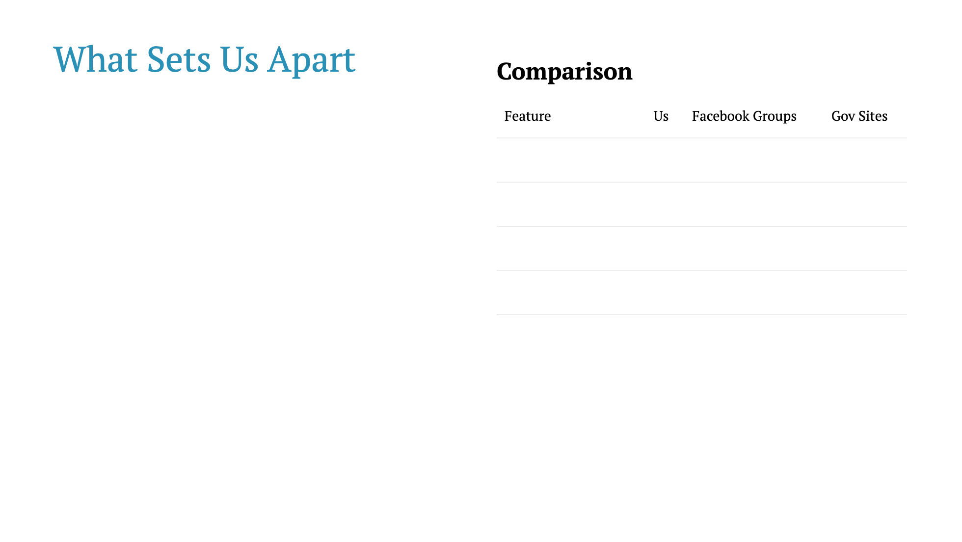

Slide 20
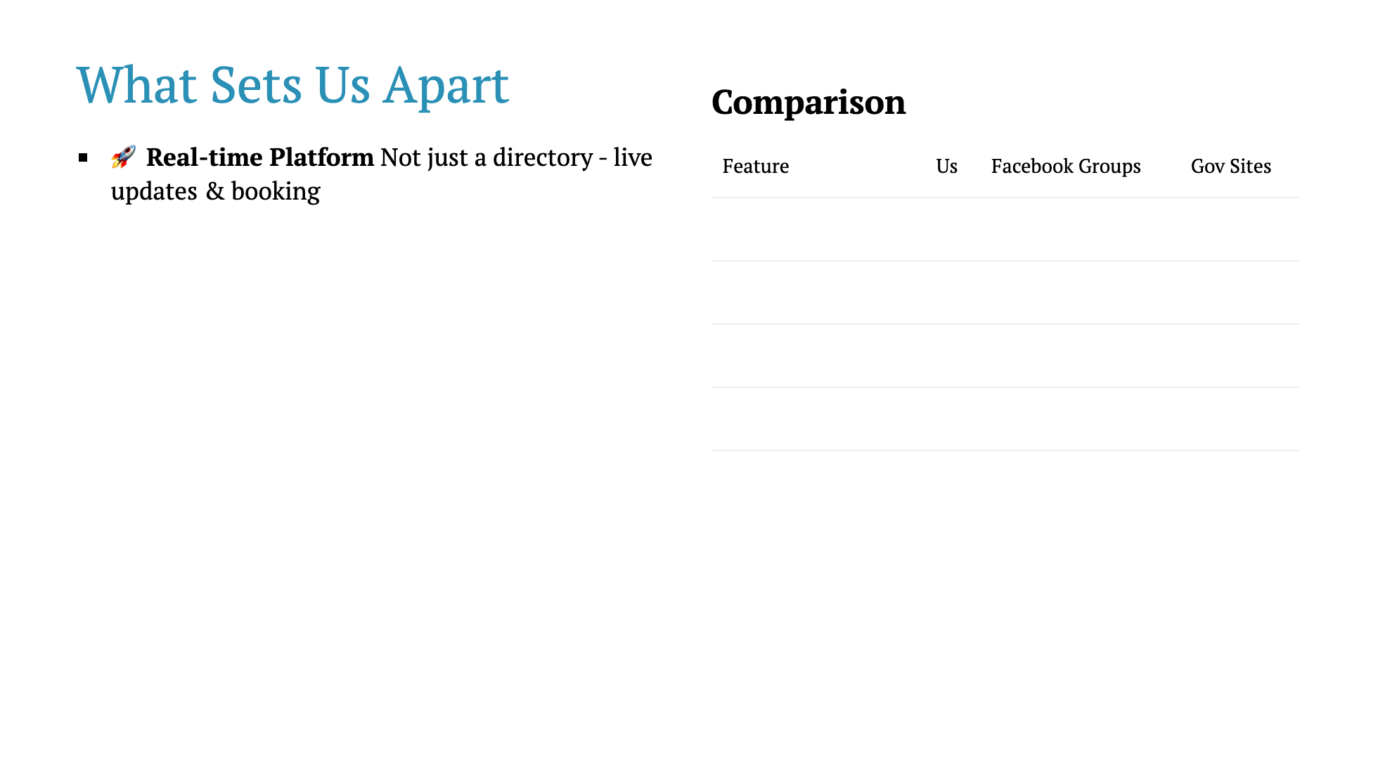

Slide 21
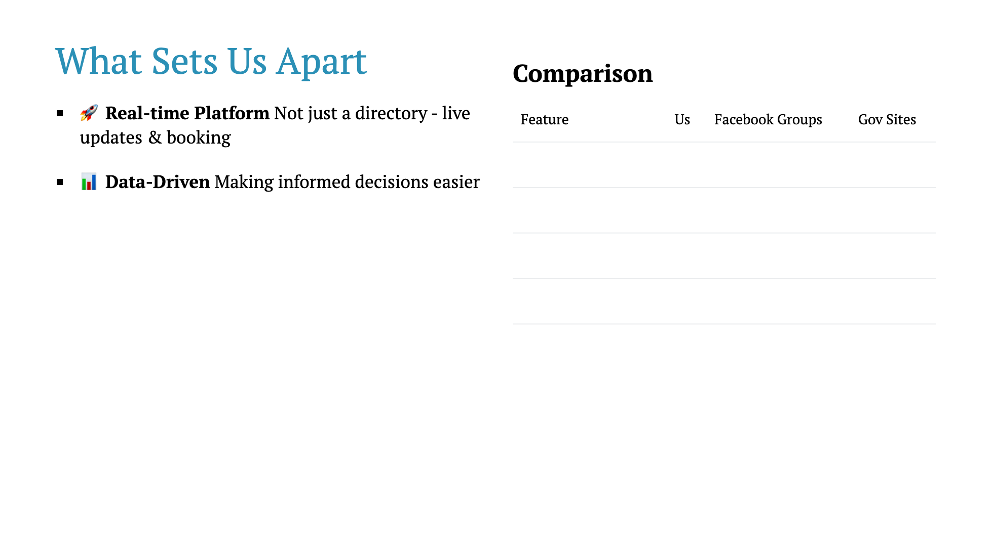

Slide 22
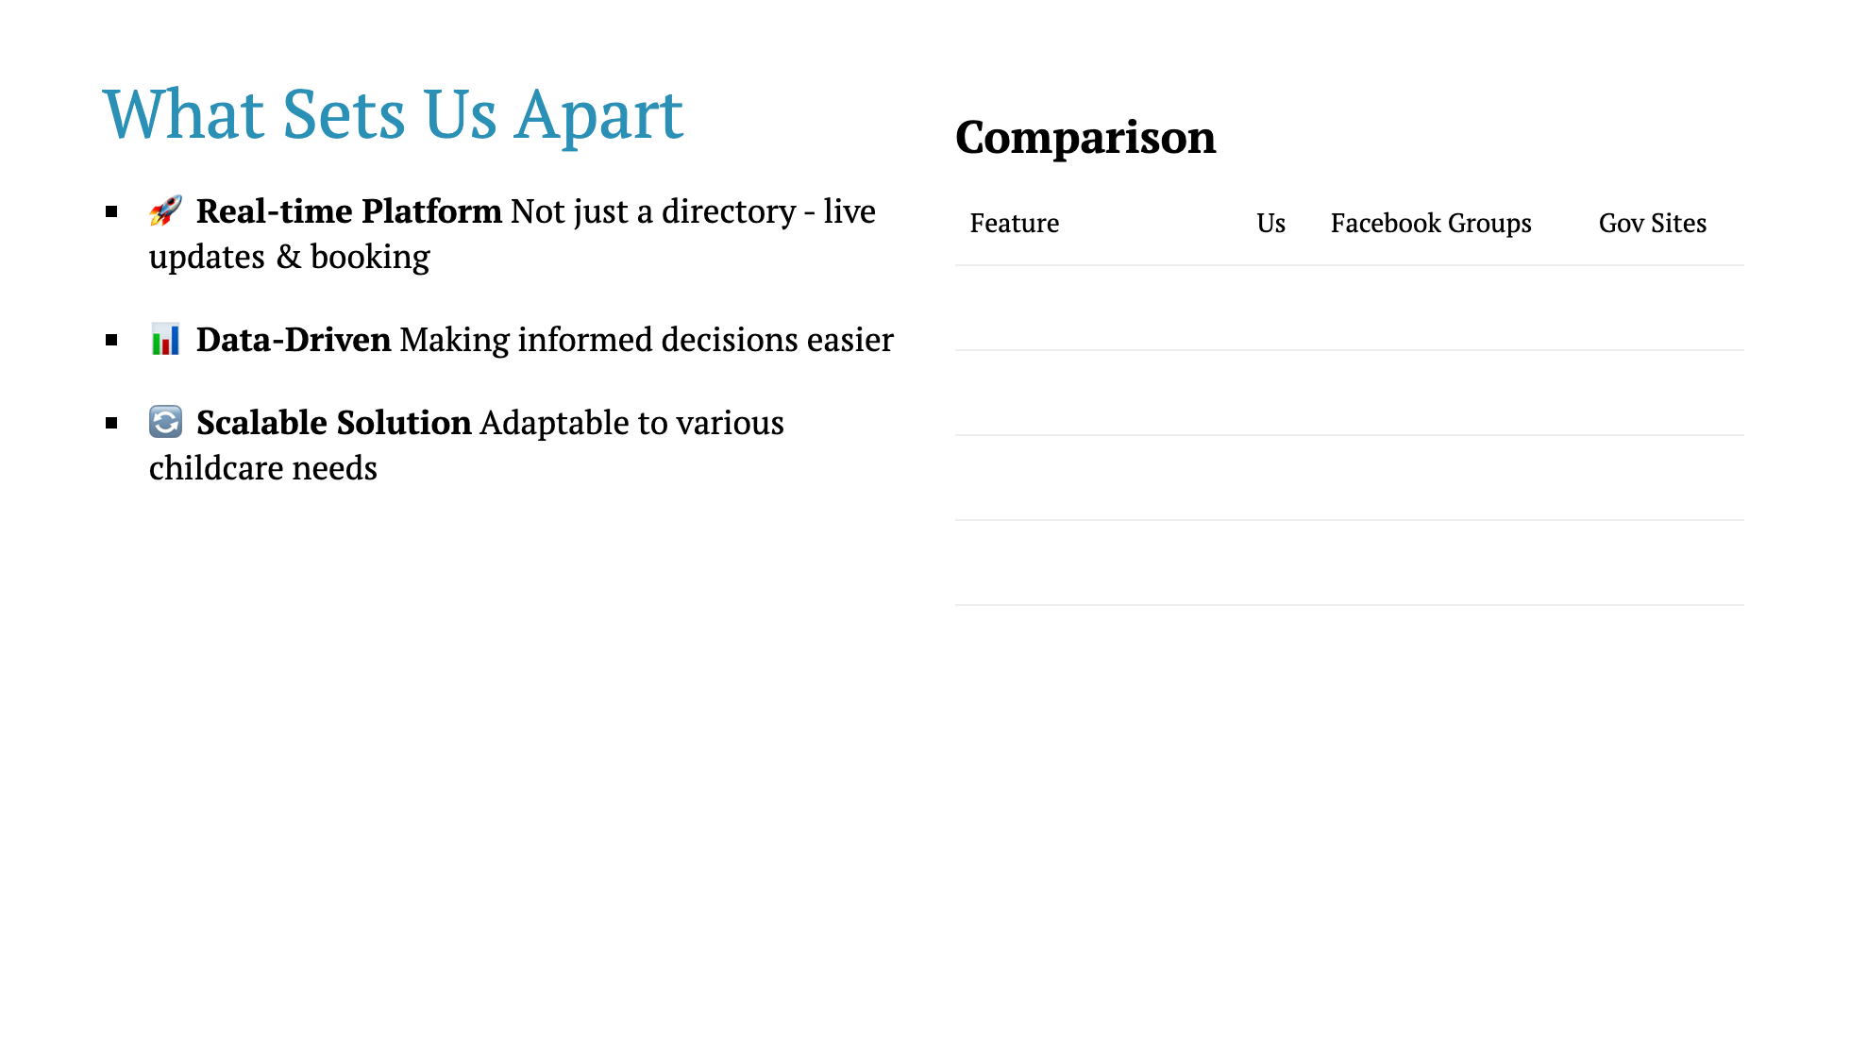

Slide 23
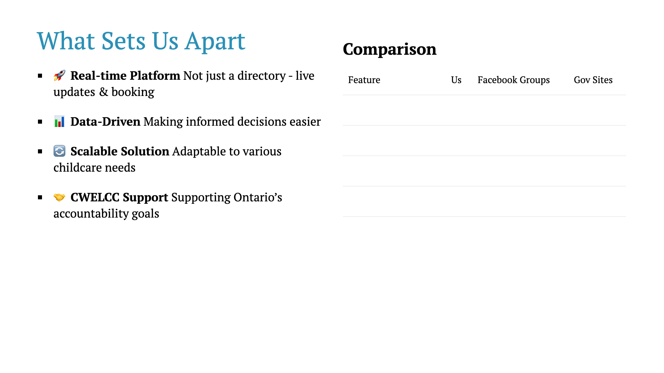

Slide 24
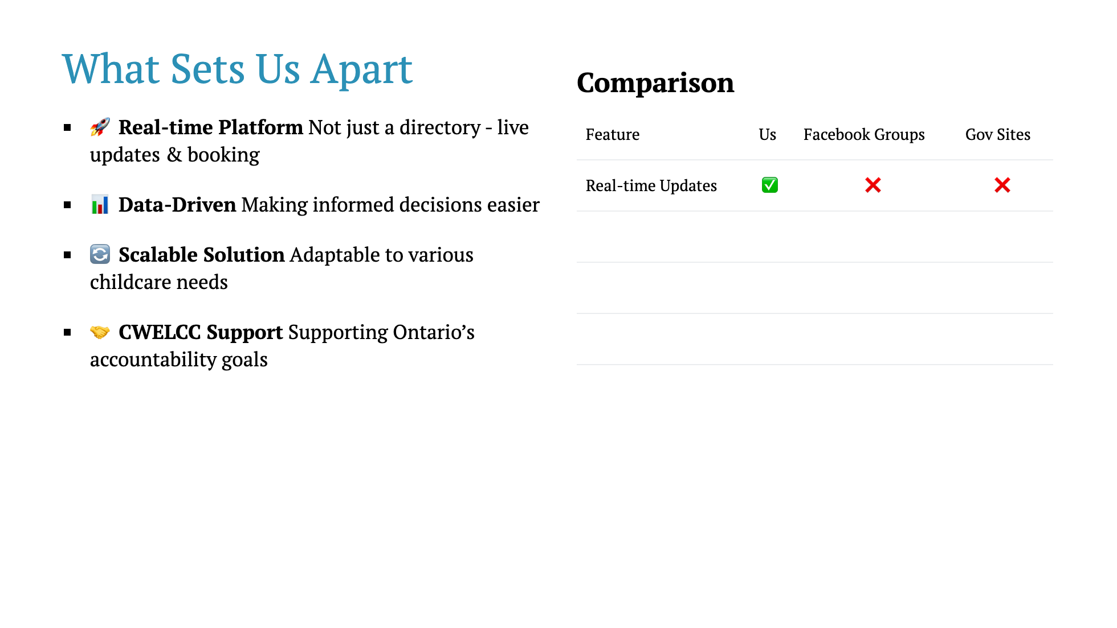

Slide 25
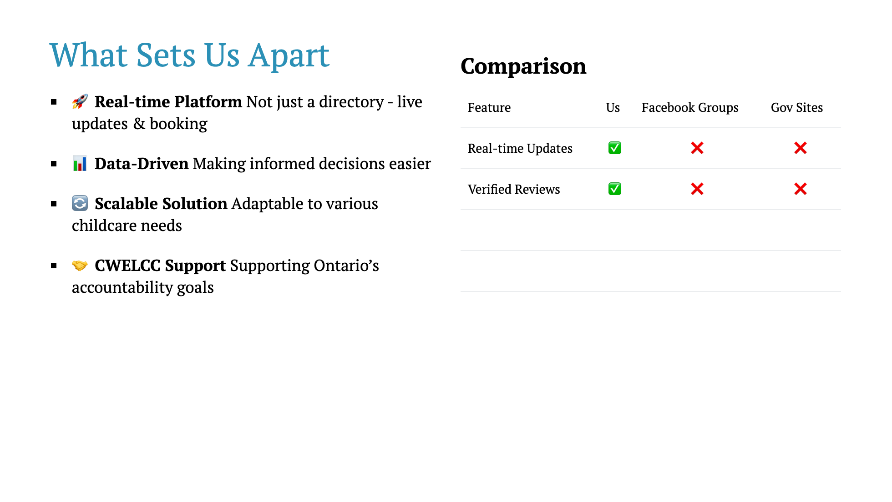

Slide 26
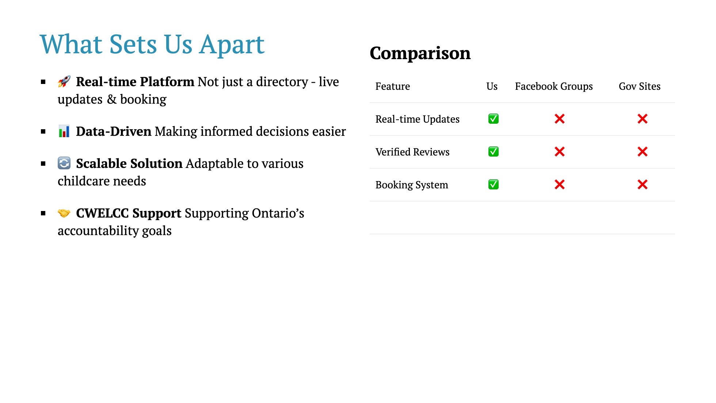

Slide 27
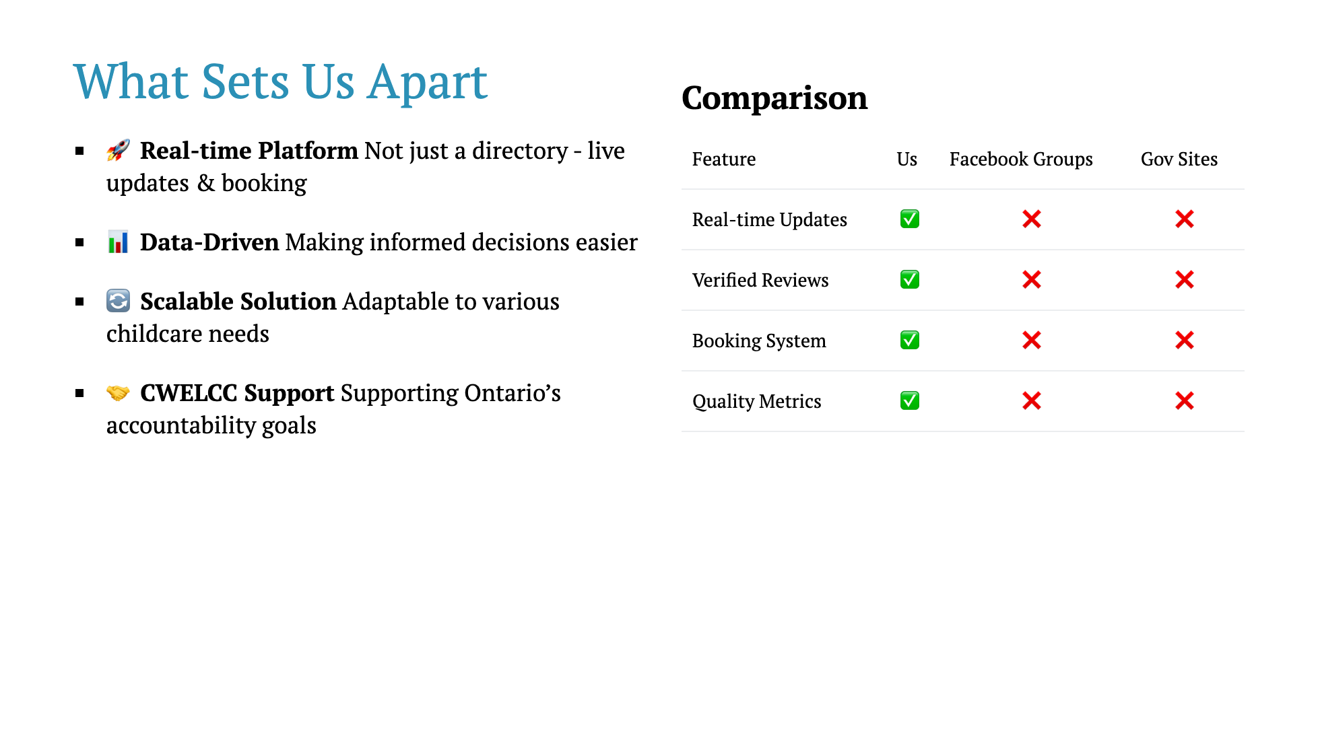

Slide 28


Slide 29
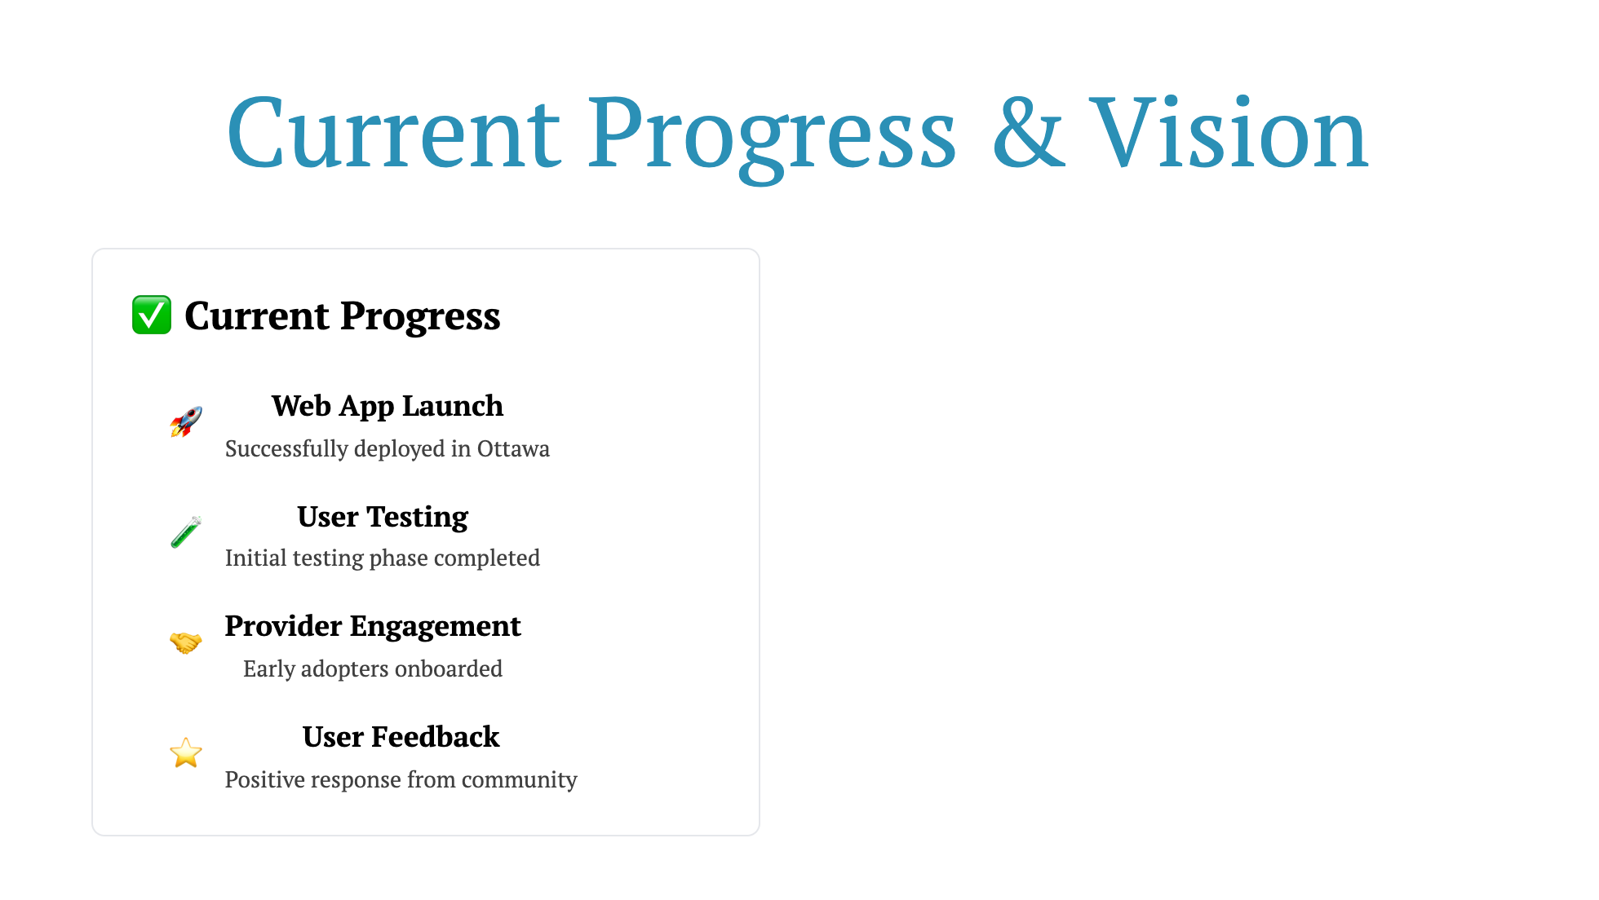

Slide 30
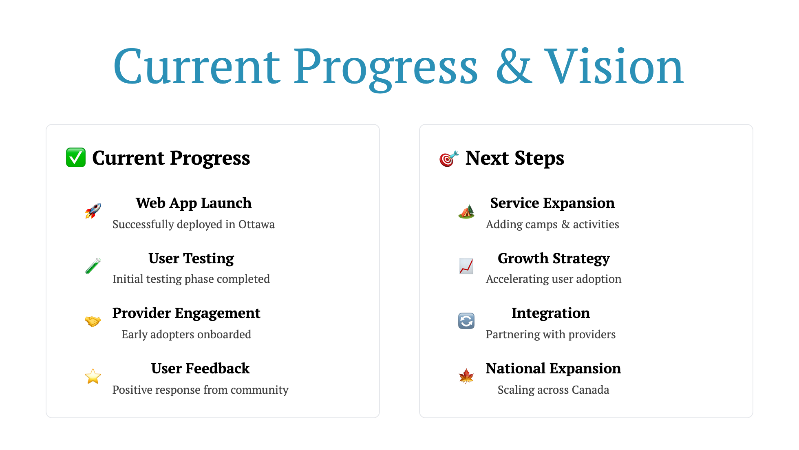

Slide 32


Slide 33
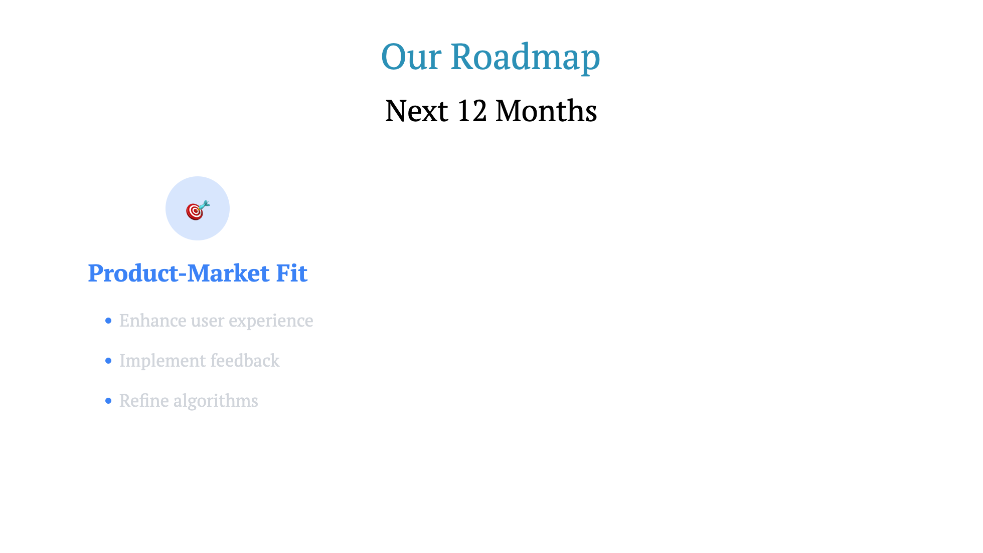

Slide 34


Slide 35
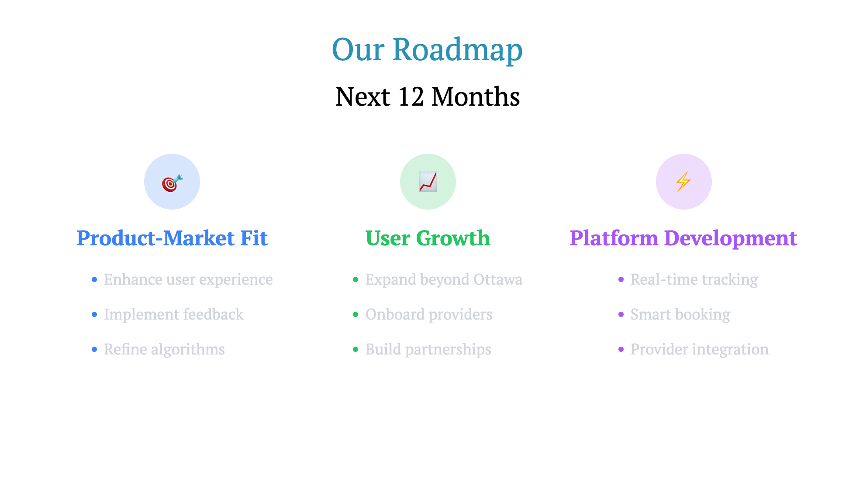

Slide 36
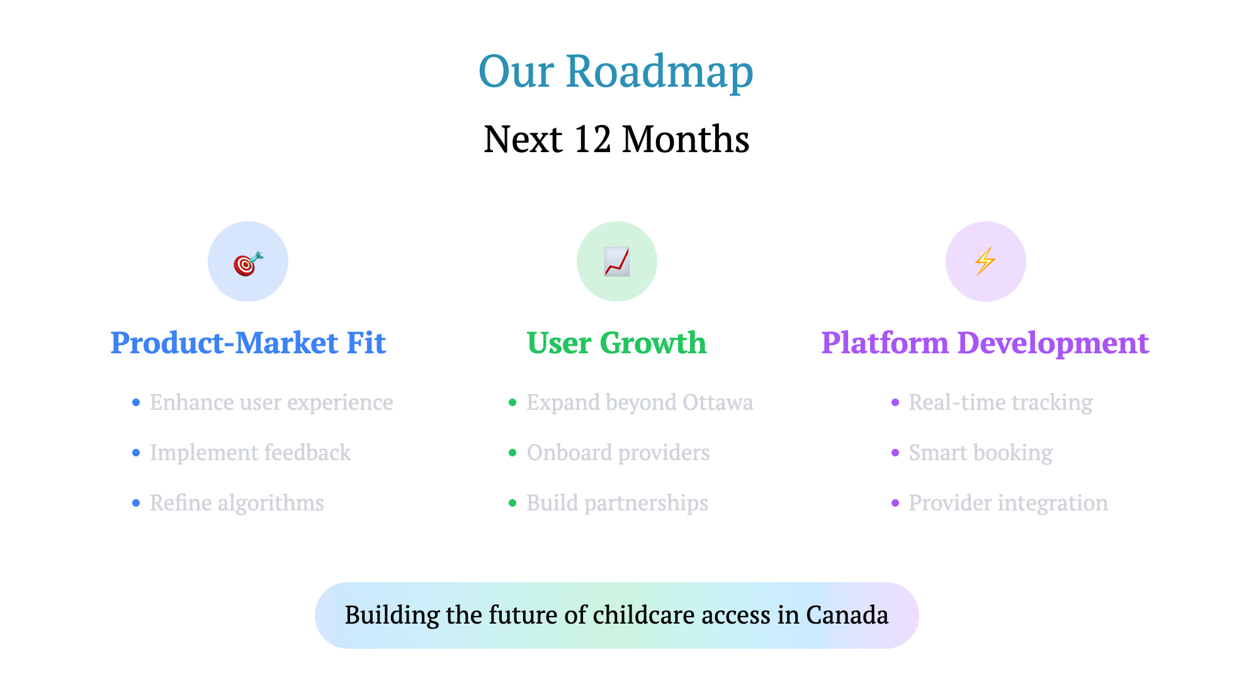

Slide 37


Slide 38


Slide 39


Slide 41

Notes:
Final call to action Emphasize the opportunity to be part of the solution

